Slide 1
QuantomBor_2 quantum generator release and presentation of its industrial control system TearUpTheSpace V2.3α
Speech by John MacKalagan - Director of Innovation

Slide 2
Our sectors of activity :
Innotechs
Presentation
Photonics technologies
Our developments in the mid-infrared have revolutionized the micromolecular detection of living organisms. As the first player convinced of the potential of photonics, we are leaders in fluorescent nanoparticles, liquid crystal bionic structures and nanoscale scanning sensors.
Quantum technologies
InnoTechs is at the heart of Innovation since 1901
Our "Back to the Quantum Past" research program develops unique and exceptionally powerful quantum computing engines. These engines offer unprecedented computing power: Innotechs is bringing humanity into the quantum era and is poised to profoundly transform our society.
Artificial intelligence
We stand out with our "Superior and Artificial Intelligence" technology. Our developments and machines will be endowed with superhuman capabilities leading to the replacement of Man in all his daily activities in the near future.

Slide 3
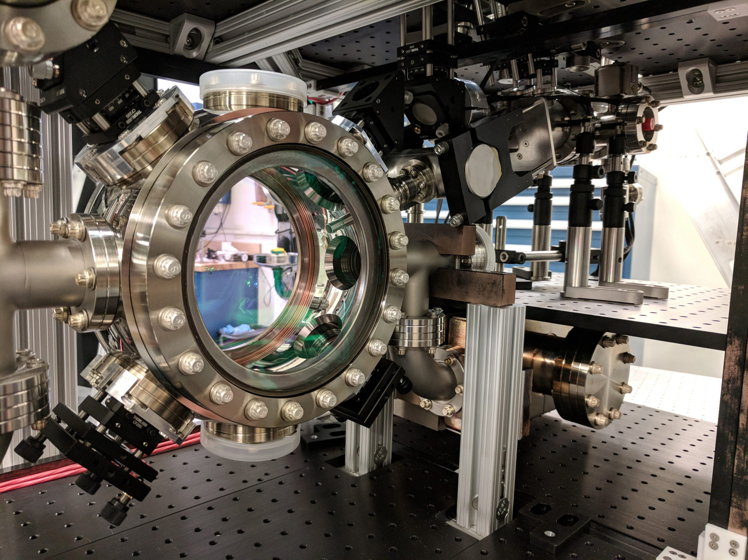
Overview of the QuantomBor_2 quantum generator
Creation of quantum gas at low temperature.
Discovered in 1924 by researchers Bose and Einstein.
In 1995, Wieman, Cornell and Ketterle obtained for the first time a Bose condensate.

Slide 4
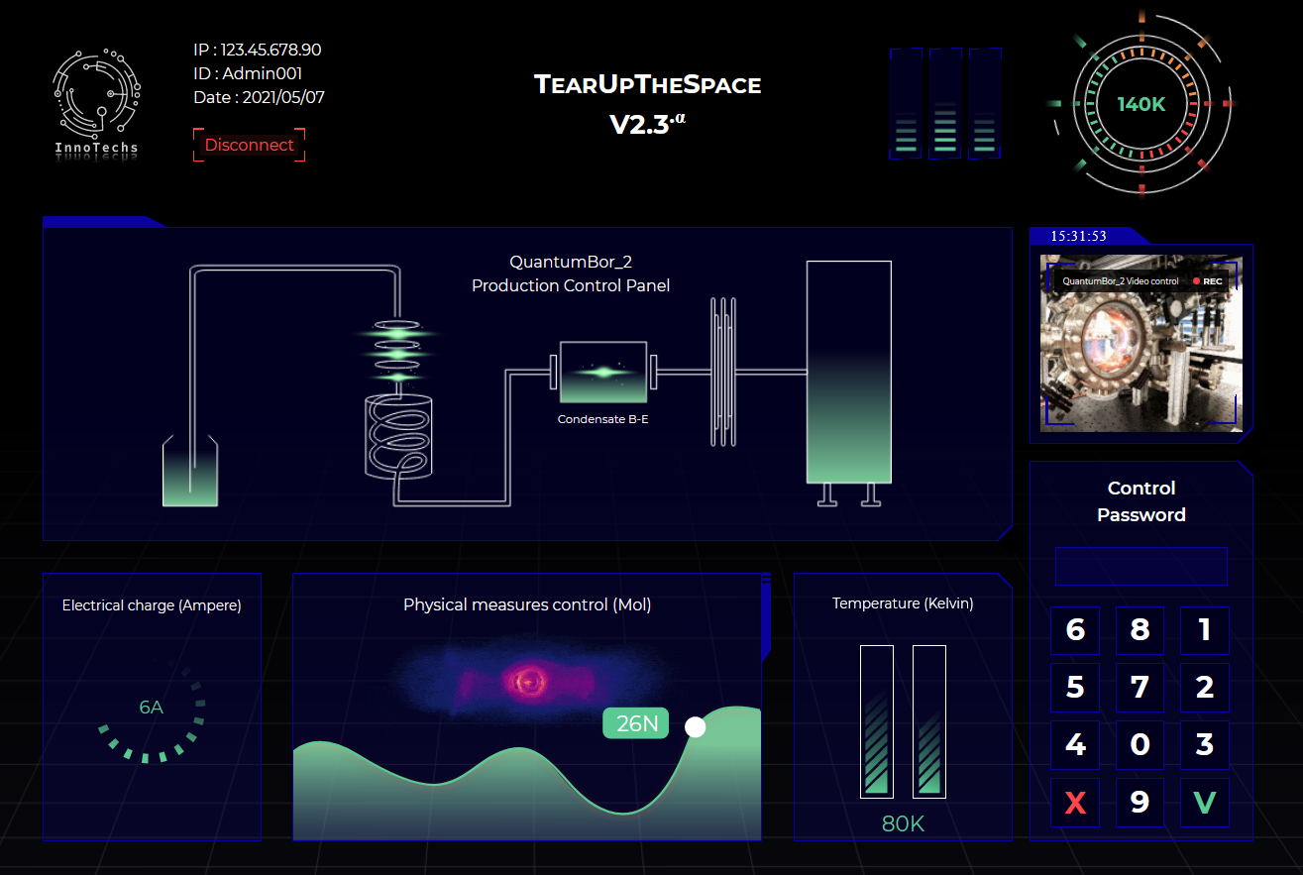
Industrial control system presentation
Electrical load of the generator
Access control for modification of the physical parameters of the generator
Control of the physical measurements of the generator
Generator temperature
Notes:
Marquos Ledau Riette (marquos.ledau_riette@external.innotechs.eu): @john.mackalagan@innotechs.eu I finished updating the operating procedure => it is here for validation : https://tinyurl.com/2vcddkzc

